Slide 1
[2-day project] Pokemon Character Classification and Prediction
천둥(Thunder) 연구실
2023.2.17 금요일
이규성

Slide 2
Tasks
Tasks
1. Understand the relationship among various Pokemon attributes
Relationships among 5 features : [height, weight, HP, attack, defense]
Attributes significantly explaining why certain Pokemon characters are classified as “legendary” or “mythical”
2. Develop a model to generate new Pokemon character
It must appropriately suggest one or more types for new character
Based on other attributes such as HP, attack, defense, etc.
Sub-task : Develop a Pokemon type prediction model based on generations 1 through 7 to make predictions for generation of 8 Pokemons
3. Develop a model to predict whether a given Pokemon character should be classified as legendary
4. Evaluate and Justify the performance of models

Slide 3

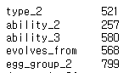
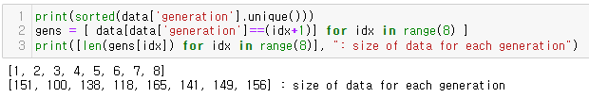
Dataset
Dataset
Complete Pokedex (V1.10) on Kaggle
Contain all information about all Pokemon and versions of Pokemon up to the 8 generations
1,118 rows with 64 columns
No duplicated rows
Columns with null value exist
Relatively even data size for each generation
Too many predictors for small dataset
63 columns in total

Slide 4
Data Preprocessing
Extreme outliers found : ‘weight’ column
Most of values in the weight column are between 0 and 99.9
Outliers with values of 10000 exist
Obvious outliers, but still can be useful information
changed the value to 999.9 (to avoid incorrect bias of data)
created a new categorical variable 'super_heavy’ to utilize this information for later tasks
Feature engineering performed
Delete columns : 11 columns
Columns containing useless information
E.g., ‘pokedex_number’, ‘pokemon_name’, etc.
Redundant columns
E.g., ‘bmi’, ‘total_stats’, ‘mena’, etc.
31 continuous variables
19 categorical variables
Label encoded to discrete numbers
Train test split :
0.7 : 0.3
Note that test set is a not validation set – used for final test

Slide 5
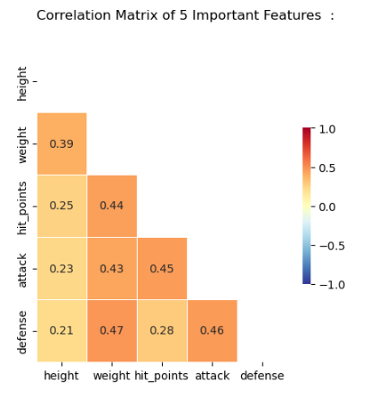
Task 1 : Understand relationship among various Pokemon attributes
Sub-task 1 : Relationships among ['height', 'weight', 'hit_points', 'attack', 'defense’]
Correlations found in the entire data
No negative correlation is found
No trade-off relationship by attribute in general
Good is good?

Slide 6
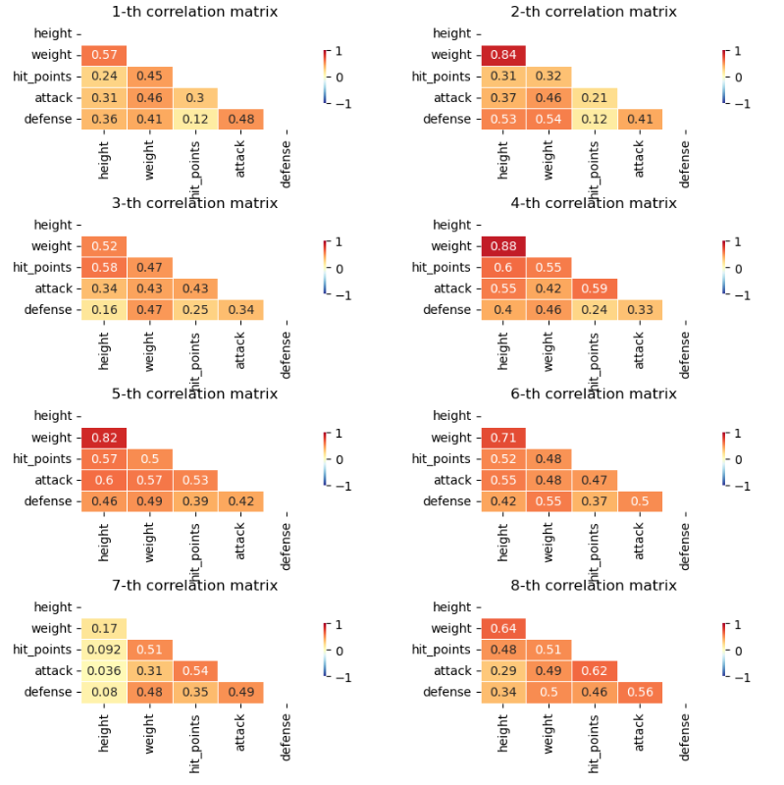
Task 1 : Understand relationship among various Pokemon attributes (cont’d)
Weight-height
Shows high correlation in most of generations
7th gen shows low correlation
Other features
2nd, 4th - 6th gens show high correlations among features
7th gen shows relatively low correlation among features
Can be seen that the correlations are different for each generation

Slide 7
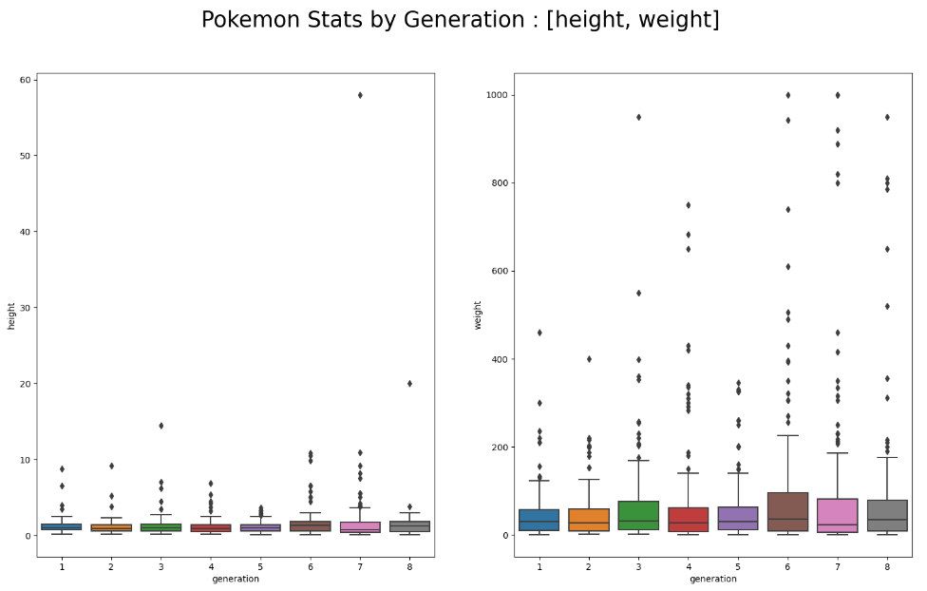
Task 1 : Understand relationship among various Pokemon attributes (cont’d)
Sub-task 2 : how to these relationships evolve over generations of Pokemon
Height, weight : (including outliers)

Slide 8
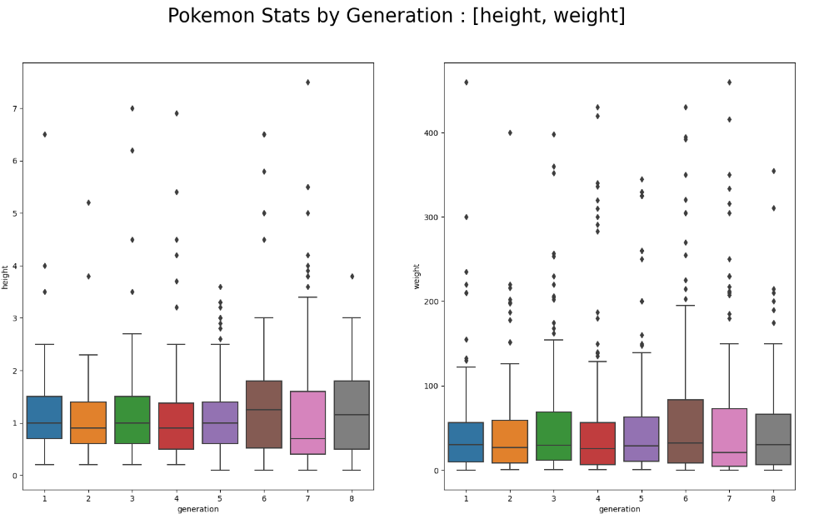
Task 1 : Understand relationship among various Pokemon attributes (cont’d)
Sub-task 2 : how to these relationships evolve over generations of Pokemon
Height, weight : (excluding outliers)

Slide 9
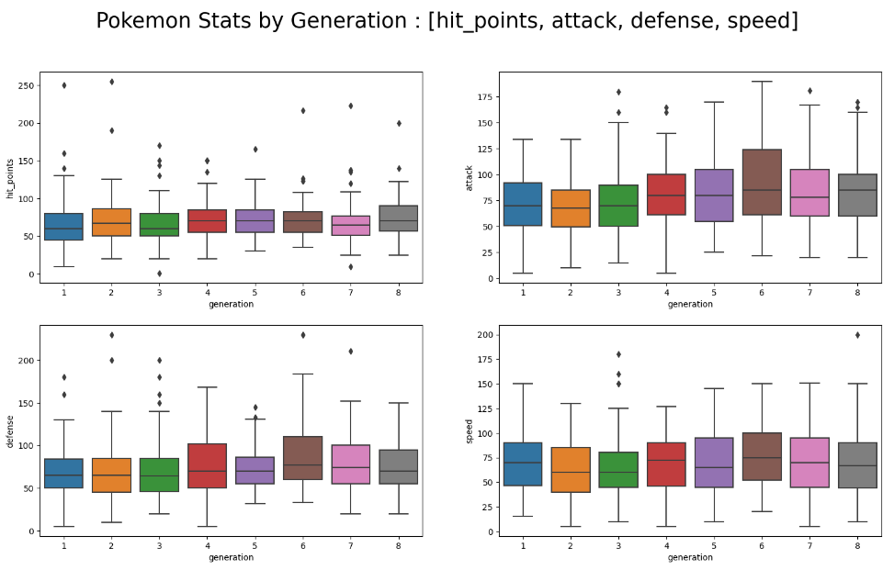
Task 1 : Understand relationship among various Pokemon attributes (cont’d)
Sub-task 2 : how to these relationships evolve over generations of Pokemon
[hit point, attack, defense, speed]

Slide 10
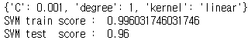
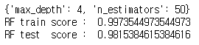
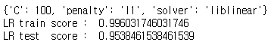
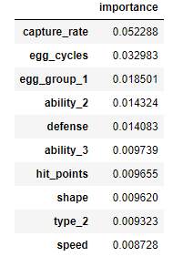
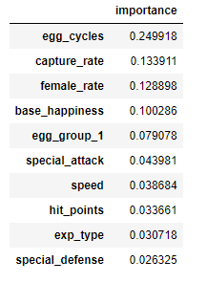
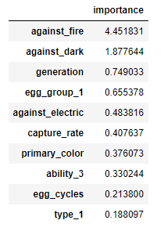
Task 1 : Understand relationship among various Pokemon attributes (cont’d)
Sub-task 3 : find significant attributes for characters to be classified as legendary or mythical
SVM, Random Forest, Logistic regression models were used :
SVM and Random Forest are suitable for dataset with many features
SVM and Logistic regression are suitable for linear classification
Lasso penalty was used for Logistic regression to prevent overfit
Used a grid-based hyperparameter search approach to achieve robust results
Most of them considered features related to ‘capture_rate’ and ‘eggs’ as important

Slide 11
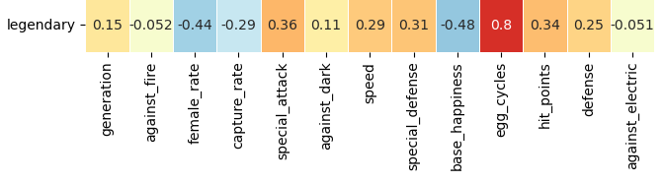
Task 1 : Understand relationship among various Pokemon attributes (cont’d)
Sub-task 3 (Task 3) : find significant attributes for characters to be classified as legendary or mythical
SVM, Random Forest, Logistic regression models were used :
SVM and Random Forest are suitable for dataset with many features
SVM and Logistic regression are suitable for linear classification
Lasso penalty was used for Logistic regression to prevent overfit
Used a grid-based hyperparameter search approach to achieve robust results
Most of them considered features related to ‘capture_rate’ and ‘eggs’ as important

Slide 12
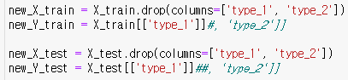
Task 2 : Develop a model to generate new Pokemon character
Make a classifier that predicts the types based on the given stats
Create a Pokemon with (1) noise added in continuous variables that follows a normal distribution (2) and random selection of categorical variables
Use the classifier to decide the type of the pokemon
Classifier fitting
X : all features except type_1, and type_2
Y1 : type_1
Y2 : type_2
Prediction targets

Slide 13
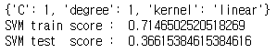
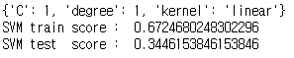
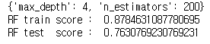
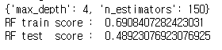
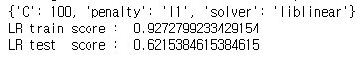
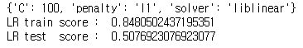
Task 2 : Develop a model to generate new Pokemon character (cont’d)
Classifier performance (type 1 and type 2)
SVM
Random Forest
Logistic Regression
SVM for type 1 prediction
Logistic Regression for type 2 prediction

Slide 14
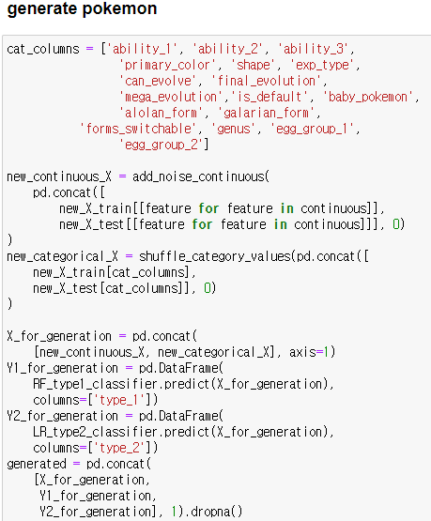
Task 2 : Develop a model to generate new Pokemon character (cont’d)
Generator
Add noise in continuous variables that follows a normal distribution
Randomly select categorical variables
Use SVM for type 1 prediction and logistic regression for type 2 prediction

Slide 15
Task 2 : Develop a model to generate new Pokemon character (cont’d)
Generator
Add noise in continuous variables that follows a normal distribution
Randomly select categorical variables
Use SVM for type 1 prediction and logistic regression for type 2 prediction

Slide 16
Task 2 : Develop a model to generate new Pokemon character (cont’d)
Generator
Add noise in continuous variables that follows a normal distribution
Randomly select categorical variables
Use SVM for type 1 prediction and logistic regression for type 2 prediction

Slide 17
Conclusion
Evaluation Metric : Accuracy
Not important to distinguish between [True positive, True negative, False positive, and False negative] for this task
Easy to implement and intuitive to understand
Result and Discussion
‘Legendary’ classification
Relatively easy task since the relationship between the label and some particular features were too high
‘Type’ classification
Models used might not be suitable for this classification task
Unlike ‘Legendary’, ‘Type’ does not seem to have a linear relationship with continuous features

